Slide 1
Maven
Maven Basics

Slide 2
Lesson Objectives
POM
Standard Directory Structure
Build Life Cycle
Plug-in
Dependency Management
Resolving Dependency Conflicts
Repositories
Notes:
Explain the lesson coverage

Slide 3
2.1 Project Object Model(POM)
POM = Project Object Model = pom.xml
Contains metadata about the Project
      Location of directories, Developers/Contributors, Issue tracking system, Dependencies, Repositories to use, etc
Example:
<project>
<modelVersion>1.0.0</modelVersion>
<groupId>com.example</groupId>
<artifactId>my-app</artifactId>
<name>my maven app</name>
<version>1.0-SNAPSHOT</version>
<packaging>jar</packaging>
<dependencies/>
<build/>
[…]
Minimal POM

Slide 4
2.1.1 pom.xml
2.1 Project Object Model(POM)
Declarative execution- POM model.
pom.xml
      <project>
        <modelVersion>1.0.0</modelVersion>
        <groupId>com.example</groupId>
        <artifactId>jmy-app</artifactId>
        <packaging>jar</packaging>
        <version>1.0-SNAPSHOT</version>
        <name>my maven app</name>
        <url>http://maven.apache.org</url>
        <description></description>
        <dependencies>
        <dependency>
        <groupId>junit</groupId>
        <artifactId>junit</artifactId>
        <version>3.8.1</version>
        <scope>test</scope>
        </dependency>
        </dependencies>
      </project>
*This pom will allow you to compile, test and generate basic documentation.
modelVersion-
Version of the object
Model this POM is using
groupId-
Unique identifier for
the project.
project-
Top level element
Of pom.xml
artifactId-
Unique base name of the
Primary artifact being
Generated by the object.
Ex. My-app-1.0.jar
version-
Version of the generated
Artifact.
SNAPSHOT- project is
In a state of development
packaging-
Type of packaging to be
Used by this artifact.
Ex. JAR, WAR, or EAR
name-
Display name used for the
Project(Full name). Often used in
Generated Documentation, during build
Process Of the project, or projects that
use it As a dependency
url-
This element indicates
Where the project’s site
Can be found.
description-
Basic description of the
Project.
Notes:
The <project> element is the root of the project descriptor.
<modelVersion> : Declares to which version of project descriptor this POM conforms.
<groupId> :A universally unique identifier for a project. It is normal to use a fully-qualified package name to distinguish it from other projects with a similar name (eg. org.apache.maven).
<artifactId > : The identifier for this artifact that is unique within the group given by the group ID. An artifact is something that is either produced or used by a project. Examples of artifacts produced by Maven for a project include: JARs, source and binary distributions, and WARs.
<packaging> : The type of artifact this project produces, for example jar war ear pom. Plugins can create their own packaging, and therefore their own packaging types, so this list does not contain all possible types.
Default value is: jar.
<Name> : The full name of the project.
<url> : The URL to the project's homepage.
<Version> : The current version of the artifact produced by this project.
<description> : A detailed description of the project, used by Maven whenever it needs to describe the project, such as on the web site.
<dependencies>: This element describes all of the dependencies associated with a project. These dependencies are used to construct a classpath for your project during the build process. They are automatically downloaded from the repositories defined in this project.

Slide 5
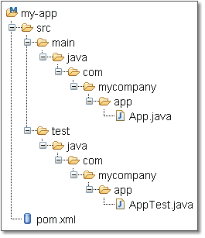
2.2 Standard Directory Layout
Having a common directory layout make
the project easier to understand by other developers.
It makes it easier to integrate plugins.
Project home directory consists of POM(pom.xml)
and two subdirectories initially:
      src : contains all source code and
      test: contains test source codes
Target directory generated after the compilation of application sources.
Directory structure before project execution
Notes:
Advantages:
– A developer familiar with Maven will quickly get familiar with a new project
– No time wasted on re-inventing directory structures and conventions

Slide 6
2.2 Standard Directory Layout
Listing out few subdirectories in src directory
Directory name | Purpose
src/main/java | Contains the deliverable Java source code for the project.
src/main/resources | Contains the deliverable resources for the project, such as property files.
src/test/java | Contains the testing classes (JUnit or TestNG test cases, for example) for the project.
src/test/resources | Contains resources necessary for testing.
src/site | Contains files used to generate the Maven project website.
Notes:
The src directory has a number of subdirectories, each of which has a clearly defined purpose. Listing out few subdirectories in src directory:
src/main/java - Contains the deliverable Java source code for the project.
src/main/resources - Contains the deliverable resources for the project, such as property files.
src/test/java - Contains the testing classes (JUnit or TestNG test cases, for example) for the project.
src/test/resources - Contains resources necessary for testing.
src/site - Contains files used to generate the Maven project website.
Additional notes for instructor

Slide 7
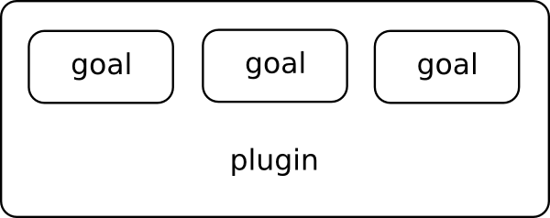
2.3 Plug-in
Maven is built using a plugin-based architecture
Each step in a lifecycle flow is called a phase. Zero or more plugin goals are bound to a phase.
A plugin is a logical grouping and distribution (often a single JAR) of related goals, such as JARing.
A goal, the most granular step in Maven, is a single executable task within a plugin.
For example, discrete goals in the jar plugin include packaging the jar (jar:jar), signing the jar (jar:sign), and verifying the signature (jar:sign-verify).
jar
jar
sign
Sign-verify

Slide 8
2.3 Plug-in
A plugin provides a set of goals that can be executed using the following syntax:
      mvn [plugin-name]:[goal-name]
Plugins reduces the repetitive tasks involved in the programming.
Plugins are configured in a <plugins>-section of a pom.xml file as shown below
<plugins>
<plugin>
<groupId>org.apache.maven.plugins</groupId>
<artifactId>maven-compiler-plugin</artifactId>
<version>2.0</version>
<configuration>
<source>1.5</source>
<target>1.5</target>
</configuration>
</plugin>
</plugins>
Notes:
For example, configuring the Java compiler to allow JDK 5.0 sources in a project. This is as simple as adding this following to your POM:
<project>
...
<build>
<plugins>
<plugin>
<groupId>org.apache.maven.plugins</groupId>
<artifactId>maven-compiler-plugin</artifactId>
<version>2.0</version>
<configuration>
<source>1.5</source>
<target>1.5</target>
</configuration>
</plugin>
</plugins>
</build>
...
</project>
This plugin will be downloaded and installed automatically, if it is not present on your local system.

Slide 9

2.3.1 Standard Maven Plugins
2.3 Plug-in
jar war ear ejb
rar pom shade
Integration
Packaging
IDEA
eclipse
clean
compiler
deploy
failsafe
install
resources
site
surefire
verifier
Core
Reporting
Tools
Changelog
Changes
Checkstyle
Clover
Javadocs
PMD
Surefire -reports
Ant
Antlr
Antrun
Archetype
Assembly
Help
Release
Others
Cargo
jaxme
jetty
Tomcat
Notes:
To see the most up-to-date list browse the Maven repository at http://repo1.maven.org/maven2/, specifically the org/apache/maven/plugins subfolder. (Plugins are organized according to a directory structure that resembles the standard Java package naming convention)

Slide 10
2.3.2 Plugin Configuration
2.3 Plug-in
Standard Plugin Configuration:
      Build plugins will be executed during the build and they should be configured in the <build/> element from the POM.
      All plugins should have minimal required informations: groupId, artifactId and version
A mojo (build task) within a plug-in is executed when the Maven engine executes the corresponding phase on the build life cycle.
Notes:
It is recommended to always defined each version of the plugins used by the build to guarantee the build reproducibility. A good practice is to specify them in the <build>
<pluginManagement/>
</build> elements for each build plugins (generally, you will define a <pluginManagement/> element in a parent POM). For reporting plugins, you should specify each version in the <reporting> <plugins/>
</reporting> elements (and surely in the <build>
<pluginManagement/>
</build> elements too).

Slide 11
2.4 Build Life Cycle
In Maven, process for building and distributing artifact is clearly defined in the form of life cycle.
Each lifecycle contains phases in a specific order, and zero or more goals are attached to each phase.
For example, the compile phase invokes a certain set of goals to compile a set of classes.
Similarly phases are available for testing, installing artifacts,..
There are three standard lifecycles in Maven
      Clean
      default (sometimes called build)
        Handle project deployment
      site

Slide 12
2.4.1 Clean Life Cycle
2.4 Build Life Cycle
clean lifecycle handles the cleaning of all project files generated by a previous build.
Running mvn clean invokes the clean lifecycle
pre-clean | executes processes needed prior to the actual project cleaning
clean | remove all files generated by the previous build
post-clean | executes processes needed to finalize the project cleaning

Slide 13
2.4.2 Default Life Cycle
2.4 Build Life Cycle
The default lifecycle handles your project deployment.
Some Key Phases in default life cycle are:
      validate
      compile
      Test
      Package
      integration-test
      Install
      deploy
Notes:
validate - validate the project is correct and all necessary information is available
compile - compile the source code of the project
test - test the compiled source code using a suitable unit testing framework. These tests should not require the code be packaged or deployed
package - take the compiled code and package it in its distributable format, such as a JAR
integration-test - process and deploy the package if necessary into an environment where integration tests can be run
install - install the package into the local repository, for use as a dependency in other projects locally
deploy - done in an integration or release environment, copies the final package to the remote repository for sharing with other developers and projects

Slide 14
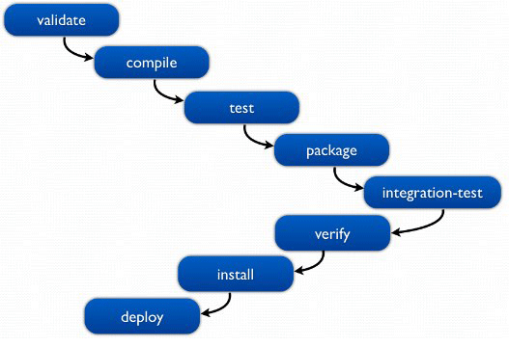
2.4.2 Default Life Cycle phases
2.4 Build Life Cycle
Notes:
The default lifecycle of Maven first validates the project, like checking the consistency of pom.xml file, and then it tries to compile the code. If the compile is successful, it then tries to run the test against the compiled code, package the project in the specified format, run the integration tests against that package, verify the package by checking for the validity, install the verified package to the local repository, and finally deploy the package in the specified environment.
To execute phases/goals we can follow the notation below in the command line:
mvn phase mvn phase:goal
We can also invoke multiple phases/goals within one command line, like:
mvn phase phase:goal mvn phase:goal phase:goal
When we invoke the mvn integration-test command, Maven executes all the phases that are registered before that phase. So the validate, compile, and package phases get executed before the integration-test phase.

Slide 15
2.4.3 Site Life Cycle
2.4 Build Life Cycle
Site lifecycle handles the creation of your project's site documentation.
You can generate a site from a Maven project by running the following command:
pre-site | executes processes needed prior to the actual project site generation
site | generates the project's site documentation
post-site | executes processes needed to finalize the site generation, and to prepare for site deployment
site-deploy | deploys the generated site documentation to the specified web server

Slide 16
2.5 Dependency Management
The dependency management is a mechanism for centralizing dependency information.
In Maven, Dependencies are defined in the POM.
<project ...>
... <dependencies>
<dependency>
<groupId>junit</groupId>
<artifactId>junit</artifactId>
<version>3.8.1</version>
<scope>test</scope>
</dependency>
</dependencies>
</project>
A
B
C
Notes:
• Dependency: a third-party or project-local software library (JAR or WAR file) of one project will be reused in another projects.
• In Maven, Dependencies are defined in the POM.
Dependency scope is used to limit the transitivity of a dependency, and also to affect the classpath used for various build tasks.
There are 6 scopes available:
• Compile - This is the default scope, used if none is specified. Compile dependencies are available in all classpaths of a project. Furthermore, those dependencies are propagated to dependent projects.
• Provided - This is much like compile, but indicates you expect the JDK or a container to provide the dependency at runtime.
Dependency, also called Coupling , a state in which one object uses a functionality of another object

Slide 17
Notes:
.For example, when building a web application for the Java Enterprise Edition, you would set the dependency on the Servlet API and related Java EE APIs to scope provided because the web container provides those classes. This scope is only available on the compilation and test classpath, and is not transitive.
• Runtime - This scope indicates that the dependency is not required for compilation, but is for execution. It is in the runtime and test classpaths, but not the compile classpath.
• Test - This scope indicates that the dependency is not required for normal use of the application, and is only available for the test compilation and execution phases.
• System - This scope is similar to provided except that you have to provide the JAR which contains it explicitly. The artifact is always available and is not looked up in a repository.
• import - This scope is only used on a dependency of type pom in the <dependencyManagement> section. It indicates that the specified POM should be replaced with the dependencies in that POM's <dependencyManagement> section. Since they are replaced, dependencies with a scope of import do not actually participate in limiting the transitivity of a dependency.
Transitive Dependencies:
Resolves Dependencies of dependencies are called transitive dependencies, and they are made possible by the fact that the Maven repository stores more than just bytecode; it stores metadata about artifacts.
Transitive dependencies allows you to avoid needing to discover and specify the libraries that your own dependencies require, and including them automatically.
For example, if you define a dependency to commons-logging and commons-logging itself defines a dependency to log4j, the commons-logging.jar and log4j.jar will be added to your build process. More formally spoken, transitiveness means that if A->B and B->C then A->C

Slide 18
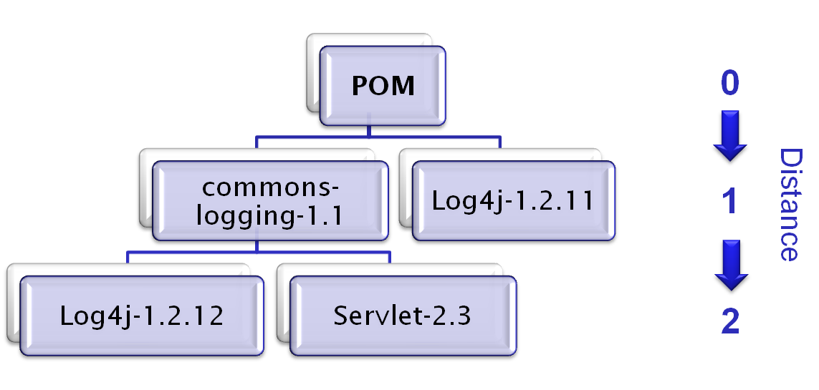
2.6 Resolving Dependency Conflicts
Conflicts arise in Maven when the same dependency (Ex. Log4j) of different version is identified in dependency graph.
While resolving such conflicts Maven traverses the dependency in a top down manner and selects the version “nearest” to the top of the tree.
For an Example, looking for Log4j-1.2.12 dependency in a dependency graph as shown below.
In this image Log4j-1.2.11 is selected as it is closer to the root of the tree.
Notes:
As the tree grows, it is inevitable that two or more artifacts will require different versions of a particular dependency.
For an Example: The sample project defines two direct dependencies: One to commons-logging-1.1 and one to log4j-1.2.11. Now, because Maven transitively loads all dependencies that are defined for commons-logging-1.1, a second version of log4j (V1.2.12) pops up in the dependency tree.
Which dependency will be used by the build process?
Answer : log4j-1.2.11 is been loaded as it is the nearest to the top of the tree.
The dependency version to be used by the build process can be recommended as follows:
<dependency>
<groupId>log4j</groupId>
<artifactId>log4j</artifactId>
<version>1.2.12</version>
</dependency>

Slide 19
2.7 Repositories
Repositories store a collection of artifacts used by Maven during dependency resolution for a project.
An artifact is a resource generated by maven project usually bundled as a JAR, WAR, EAR, or other code-bundling type.
For an example, junit.jar is an artifact.
An artifact in repositories can be uniquely identified using coordinates:
      The group ID
      The artifact ID
      The version
Maven has two types of repositories:
      Local
      Remote
Notes:
The poor approach:
Replicating all dependencies for every project (put in /lib folder within the project)
– Dependencies are replicated and use more storage
– Checking out a project will be slow
– Difficult to keep track of versions
• The preferred solution: Use a repository

Slide 20
2.7.2 Using artifact from Repositories
2.7 Repositories
Web Server
project.xml (POM)
_{Download artifact}
₁
_{Get dependencies}
Maven core
₃
Remote
Repository
_{HTTP}
Local
Repository
₂
₄
Checks if artifact exists in local repo.
Save artifact in local repository
_{JVM 1}
_{JVM 2}

Slide 21
Summary
POM
Standard Directory Structure
Build Life Cycle
Plug-in
Dependency Management
Resolving Dependency Conflicts
Repositories
Notes:
Additional notes for instructor

Slide 22
Review Question
Question1: Clean Life cycle phases are _____, _________, _________
Question 2: Which command generates default Site for a Maven Project?
Question 3: Plugin used for running JUnit tests _________.
Question 4: For identifying artifact in repositories, coordinates required are _________, _______ and ____________.
Notes:
Answers for the Review Questions:
Question 1: pre-clean, clean post-clean
Question 2: mvn site
Question 3: surefire
Question 4: groupId, ArtifactId and version

Slide 23
Review Question
Question 5: Invoking the deploy phase deploys the application in which environment?
      Option 1: Local repository
      Option 2: Release environment
      Option 3: External Repository
Notes:
Questions: Answers for the Review Questions:
Question 5: Option 2

